Slide 1


Microsoft® Lync™ 2010
Response Group Application Training

Slide 2
Objectives
This course covers the following topics:
Understanding Response Groups
Getting to Know Types of Agent Groups
Using the Anonymization Feature
Signing in and Accepting a Call
Navigating the Conversation Window During a Call
Learn how Lync 2010 Users interact with Response Groups

Slide 3
Overview of Response Groups
Response groups provide a way to route and queue calls to groups of people who manage phone calls – such as a small help desk, or a customer service desk. The people who answer the calls are designated as agents, and the agents are assigned to groups. Response Group Managers are responsible for setting up and configuring response groups.
Any agent assigned to a group can answer a call to the group. (The agent may need to be signed in to receive group calls.)
Incoming calls go through a routing method to find the next available agent.
If no agent is available, the call goes into a queue and the caller hears music until an agent is available. (All callers hear music until the call is answered regardless of agent availability.)
Agents can use Lync 2010, Attendant, or Phone Edition to take calls.

Slide 4

Types of Agent Groups
When Response Group Managers configure the response group, they can designate agents as formal or informal. This affects how the agents sign in to the queue.
Formal agents have to sign in to their response group to take calls for the group.
Informal agents are automatically signed in when they sign in to Lync 2010, Attendant, or Phone Edition.
Informal
Formal

Slide 5
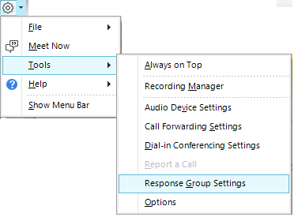
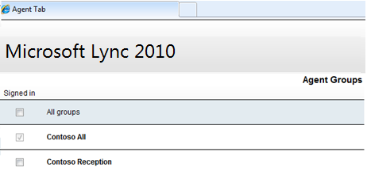
Signing in to Agent Groups
You need to sign in to your agent group before you can take calls for the group if the group is formal. You are automatically signed in to informal agent groups. You can easily access the Agent page from Lync 2010 to sign in to your agent groups.
In Lync 2010, click the menu arrow, click Tools, and then click Response Group Settings.
A browser opens and displays the Agent Groups page. This page lists all the groups for which you are an agent, and shows whether you are signed in to a group.
If you are signing in to a formal group, check the Signed in box next to the group.
If you are part of an informal group, you are automatically signed in when you sign in to Lync 2010. You cannot clear the Signed in check box for these groups.
Notes:
Formal groups are groups that you need to manually sign into before you can take calls. To sign in, check the Signed in box next to the group.
Informal groups are groups that you are automatically signed into when you sign into Lync 2010. You cannot uncheck the Signed in checkbox for these groups.

Slide 6
Agent Anonymization
Agent Anonymization is a feature that is new to Lync 2010. It is a mechanism that hides the identity of the agent making or receiving a call to or from an external user on behalf of a response group.
Agent Anonymization is configured as the property of the response group by the Response Group Manager.
If Anonymization is turned on for a response group, all calls via the response group would hide the agent’s identity and your name will not appear in the Lync 2010 conversation window when you answer a call.
Notes:
NOTE: Add screenshot of anonymous Lync 2010 window/conversation.

Slide 7
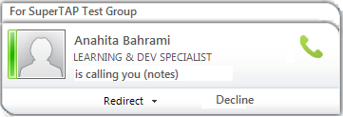
Answering a Call
Once you are signed in to a group you can answer a call.
An incoming call alert will show you which group is routing the call to you.
To answer the call, just click the alert.
Group
Caller Information
Answer the Call
Call Handling Options

Slide 8
During a Call
After you’ve answered a call, a conversation window opens. At the top of the window, you can see the name of the response group that routed the call to you.
The conversation area of the window shows Notes from the (group name) along with information that helps set the context for the phone call.
You can see how long the caller waited to connect with you. (This is only available if the response group is an IVR.)
If callers are given options when they first connect, you can see the instructions the caller heard along with the option the caller selected.

Slide 9
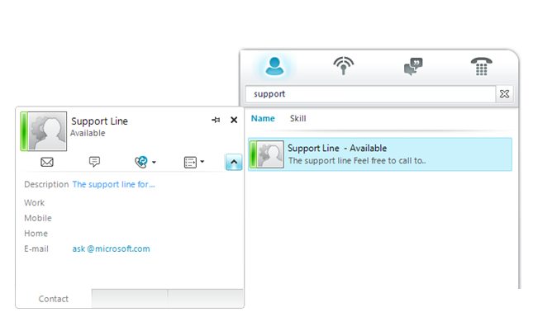
Response Groups and Lync 2010 Users
Other Lync 2010 users can search for a response group as they do for any other contact.
They can call the group directly from Lync 2010.

Slide 10
Review
This course covered the following topics:
Understanding Response Groups
Getting to Know Types of Agent Groups
Using the Anonymization Feature
Signing in and Accepting a Call
Navigating the Conversation Window During a Call
Learn how Lync 2010 Users interact with Response Groups

Slide 11


© 2010 Microsoft Corporation. All rights reserved. Microsoft, Exchange ActiveSync, Excel, Lync, Outlook, PowerPoint, SharePoint, SQL Server, Windows, Windows Live, Windows Mobile, Windows Server, and other product names are or may be registered trademarks and/or trademarks in the United States and/or other countries/regions. The information herein is for informational purposes only and represents the current view of Microsoft Corporation as of the date of this presentation. Because Microsoft must respond to changing market conditions, it should not be interpreted to be a commitment on the part of Microsoft, and Microsoft cannot guarantee the accuracy of any information provided after the date of this presentation. MICROSOFT MAKES NO WARRANTIES, EXPRESS, IMPLIED OR STATUTORY, AS TO THE INFORMATION IN THIS PRESENTATION.
BACK TO OBJECTIVES

